Slide 1

Capstone
Project
Group 5
Java Course

Slide 2



Team Roles Distribution
Hadis Delbord
Simulation of the Energy Sources
Energy source manager
Battery manager
Charge of batteries with progress bar
Logs of energy source (write log)
Unit test of energy source
Yug Dave
Simulation of the Smart Objects
Smart object manager
Consumption of smart objects
Logs of smart objects (write log)
Unit tests
Amir Hossein Pakdel
Management system for the house consumption
User Interface
Logs management (read, delete, export, filter)

Slide 3
System Requirements
Energy Source Management
Battery Management
Smart Object Management
The system should use different energy sources for concurrent charging of multiple batteries, allowing smart objects to consume power
The system must be able to handle multiple batteries, support charging and discharging operations for batteries, track battery charge levels.
The system must allow adding, activating, and deactivating smart objects. Each smart object should have an energy requirement, and the system should manage concurrent energy consumption by multiple smart objects

Slide 4
System Requirements
Log Management
User Interaction
The system should maintain logs for actions performed by smart objects and energy sources (e.g., battery usage, switching) and also allows logs to be filtered by object name, energy source name, or date. The system must support exporting logs in CSV format to facilitate record-keeping and data analysis.
The system should have a user interface to connect energy sources based on weather to batteries, add and manage smart objects (e.g., on/off), display logs, and view battery status.

Slide 5
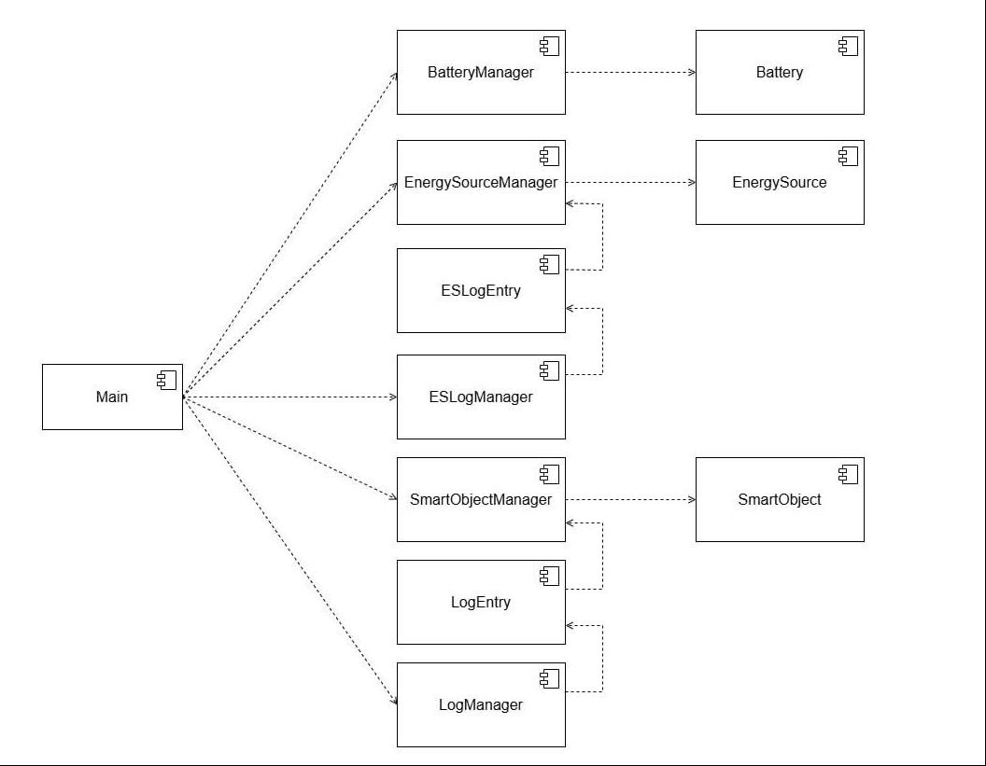
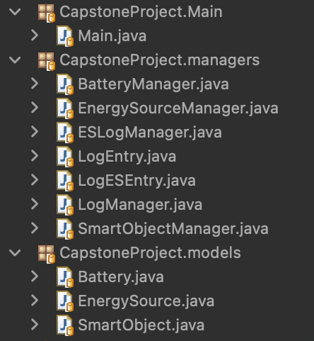
Component Diagram

Slide 6
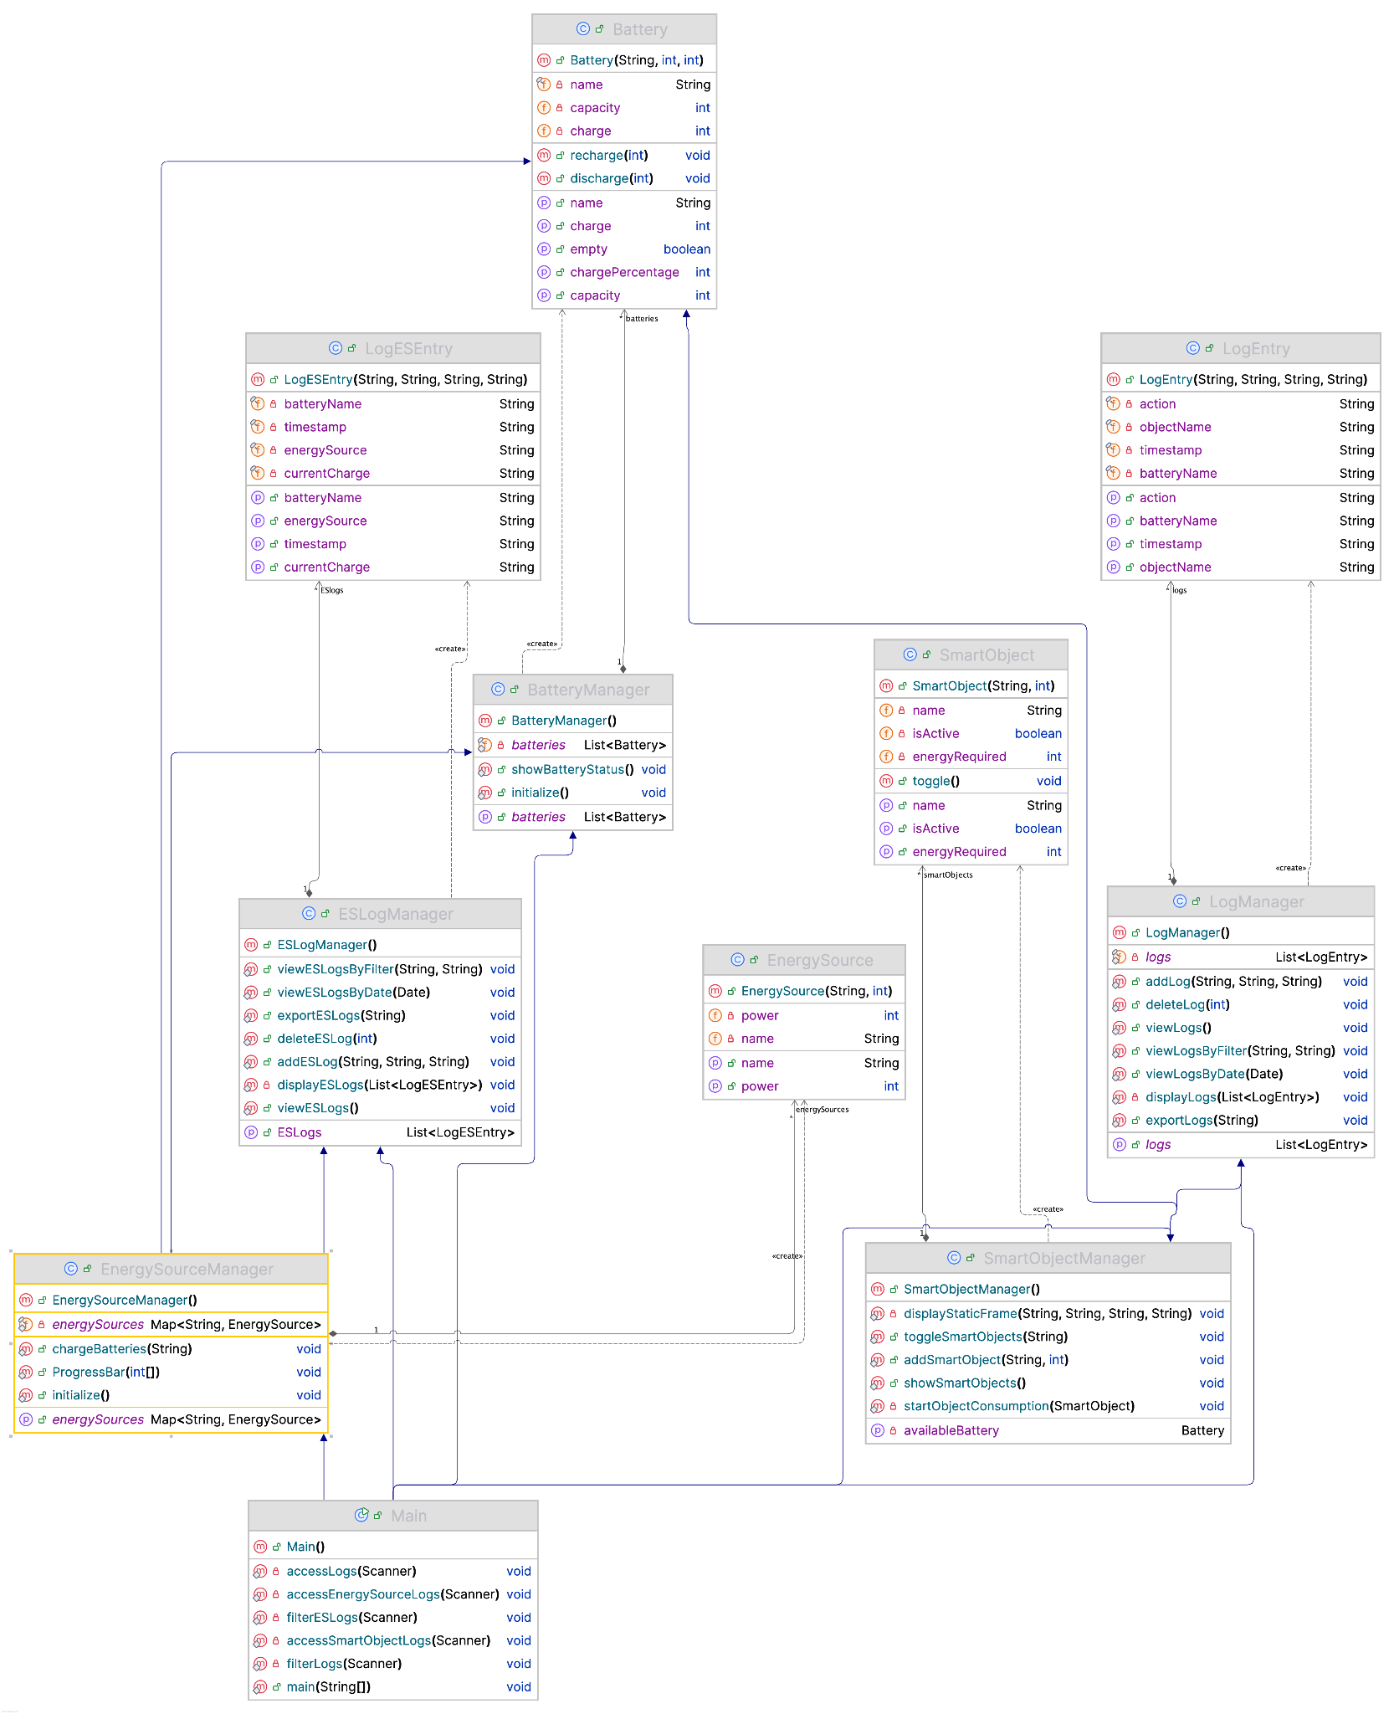
UML Class Diagram

Slide 7
Implementation

Slide 8
Management I/O
The system handles input and output for various operations across different modules, enabling user interactions and facilitating concurrent activities like charging batteries and controlling smart objects.
Battery and Energy Source Management
Users select weather conditions (e.g., sunny, rainy) to choose an energy source.
Charging progress is displayed via dynamic progress bars updated in real time.
Smart Object Management
Users can define smart objects by providing a name nad required energy
Users can toggle the state of smart objects (on/off), which directly impacts battery consumption.
Consumption progress is displayed
Log management and Exporting
Users can view logs (LogManager and ESLogManager) by filtering (e.g., by battery or date).
Logs can be exported to files for record-keeping.

Slide 9
User Interface
Menu
Easy-to-use menu-driven options for managing batteries, energy sources, and smart objects.
Real-time feedback for every user action (e.g., "Battery fully charged," "SmartLamp turned on").
Progress Displays:
Dynamic progress bars for monitoring battery charging in real time.
Progress bars while smart object consume batteries
Logs and Reports:
Display logs in tabular format on the console.
Export logs to files for detailed analysis.

Slide 10
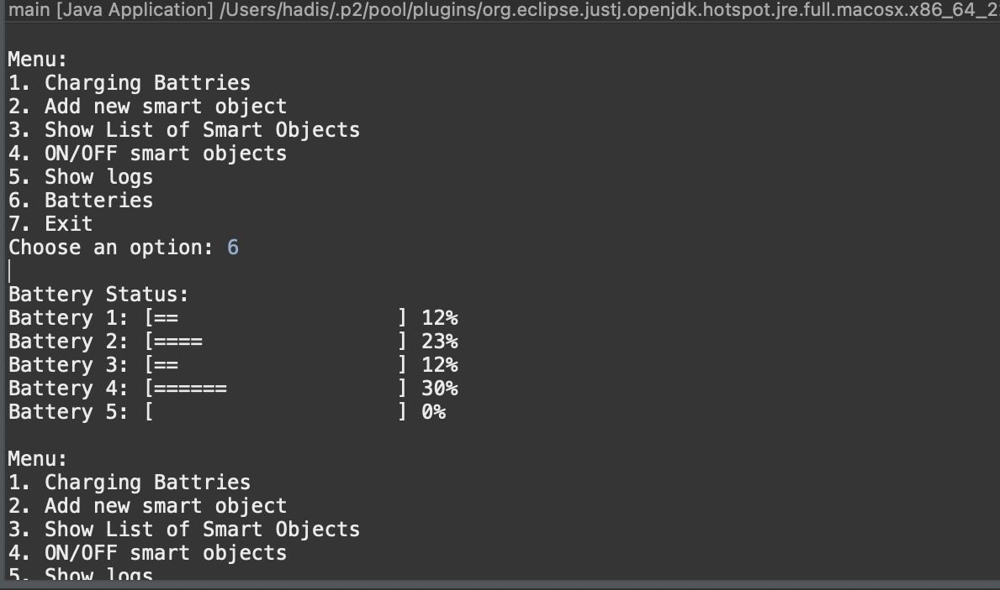
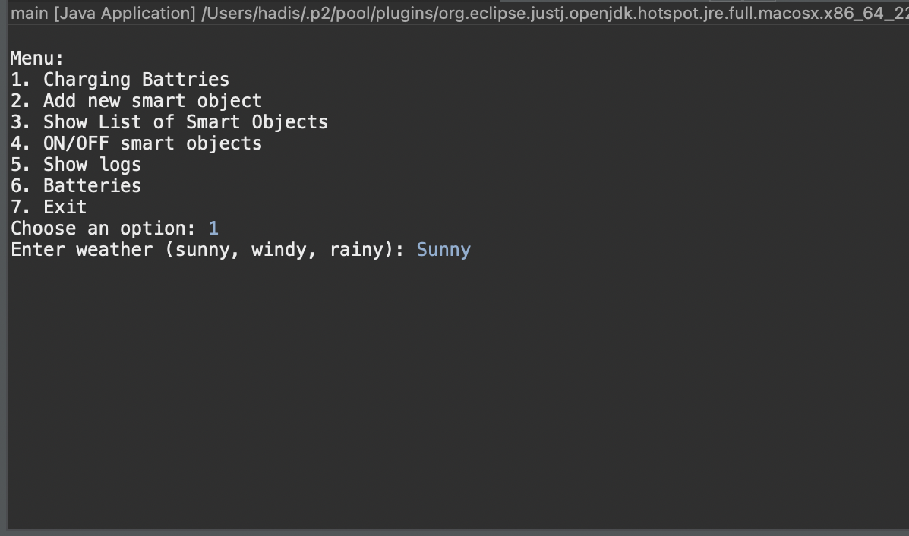
User Interface

Slide 11
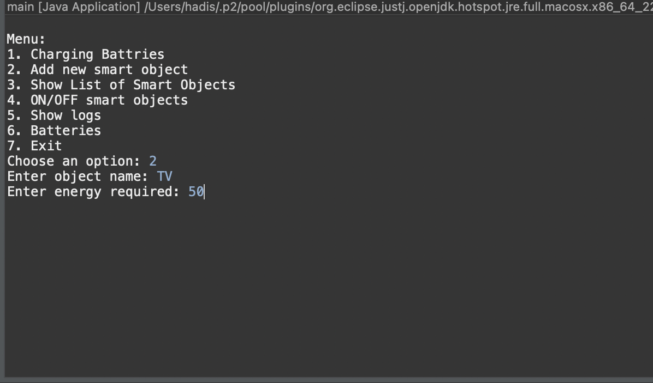
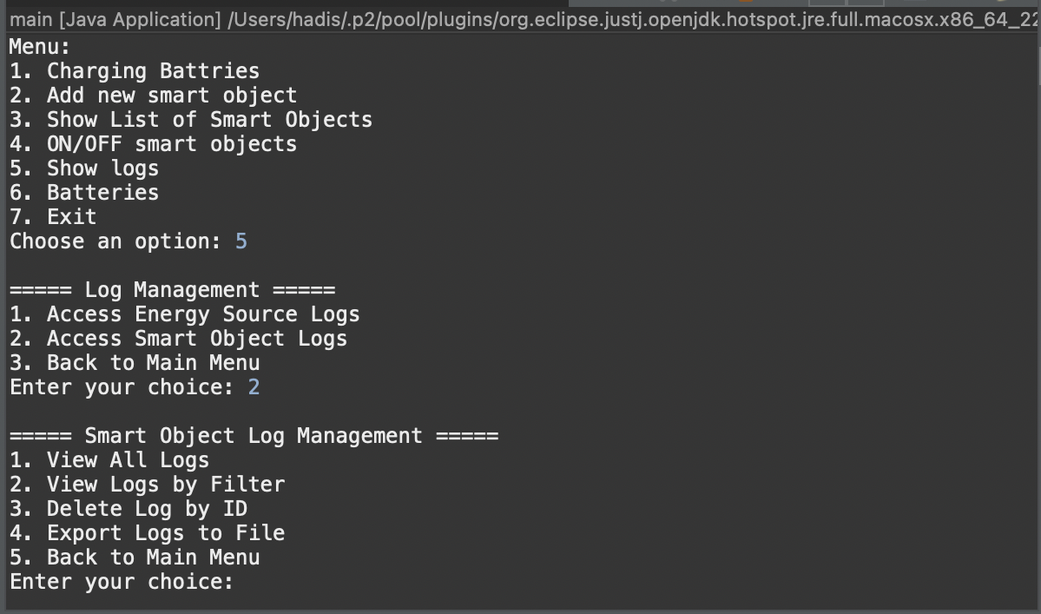
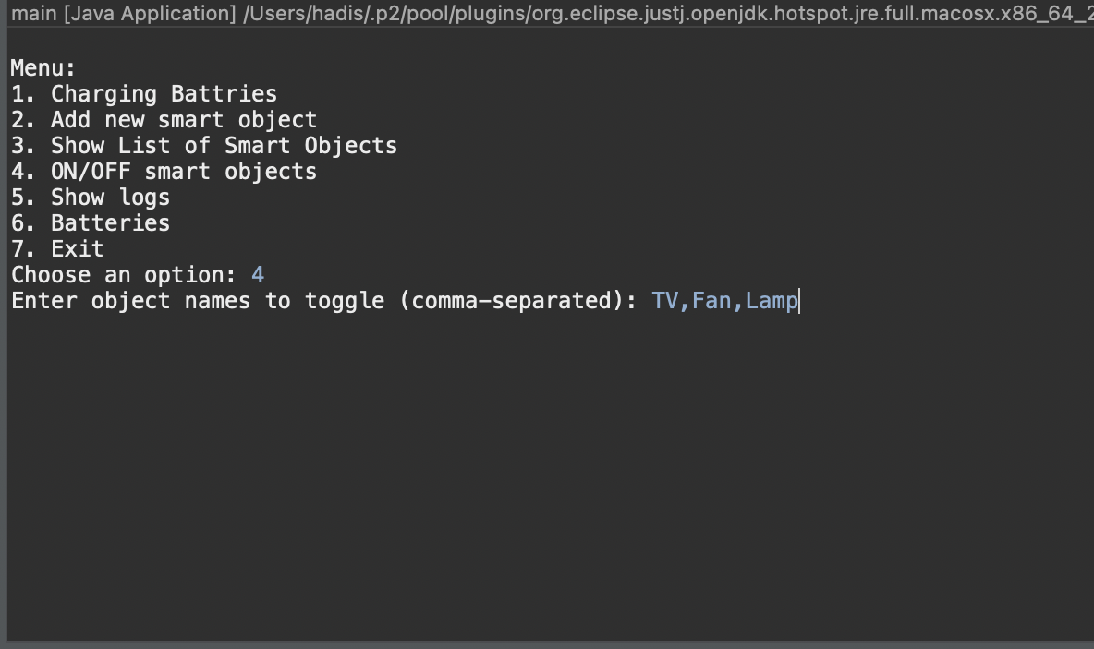
User Interface

Slide 12
Concurrency
Battery Charging:
Uses multithreading to charge multiple batteries simultaneously.
Each battery runs in a separate thread to ensure efficient use of resources.
Charging status is updated in real time
Smart Object Operations:
Allows multiple smart objects to operate concurrently, consuming energy from batteries.

Slide 13
Concurrency (Battery Charging)
List<Thread> threads = new ArrayList<>();
for (int i = 0; i < batteries.size(); i++) {
int index = i; // Required for use in lambda expression
Battery battery = batteries.get(i);
Thread chargingThread = new Thread(() -> {
while (true) {
synchronized (battery) { // Ensure thread-safe access
if (battery.isFull()) {
break; // Exit if battery is fully charged
}
battery.recharge(source.getPower()); // Increment battery charge
synchronized (percentages) {
percentages[index] = battery.getChargePercentage(); // Update percentages
}
ESLogManager.addESLog(source.getName(), battery.getName(), String.valueOf(battery.getCharge()));
}
// Simulate charging time
try {
Thread.sleep(500); // Adjust the speed of charging
} catch (InterruptedException e) {
Thread.currentThread().interrupt();
System.out.println("Recharging interrupted for " + battery.getName());
return; // Exit the thread
}
}
});

Slide 14
Concurrency (Consuming Energy )
Thread consumptionThread = new Thread(() -> {
try {
while (object.isActive() && !stopFlag.get()) {
Battery battery = getAvailableBattery();
if (battery == null) {
displayStaticFrame(object.getName(), "No batteries available", "---", "---");
LogManager.addLog(object.getName(), "None", "No Batteries Available");
break;
}
boolean consumed = false;
try {
batteryLock.lock();
if (battery.getCharge() >= object.getEnergyRequired() && !stopFlag.get()) {
battery.discharge(object.getEnergyRequired());
consumed = true;
displayStaticFrame(object.getName(), "Consuming power", battery.getName(), battery.getChargePercentage() + "%");
LogManager.addLog(object.getName(), battery.getName(), "Consuming Power");
}
}
}
Thread.sleep(1000); // Simulate time taken for energy consumption
}
} catch (InterruptedException e) {
System.out.println("Consumption interrupted for " + object.getName());
Thread.currentThread().interrupt();
}
});

Slide 15
Unit Test
Main Test
Energy Source Manager Test
Smart Object Manager Test
Energy source Log Manager Test
Energy Source Log Entry Test
Smart Object Log Manager Test
Smart Object Log Entry Test
Get Object Name Test

Slide 16
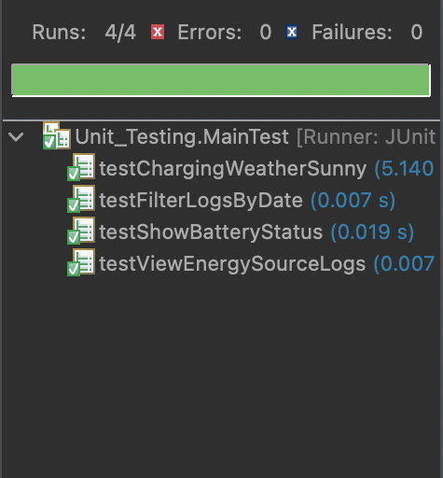
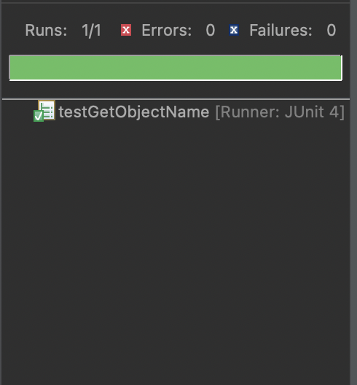
Unit Test

Slide 17
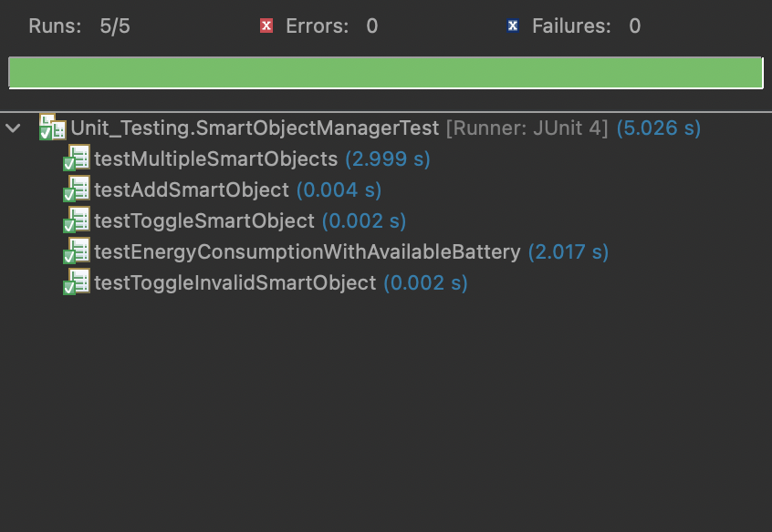
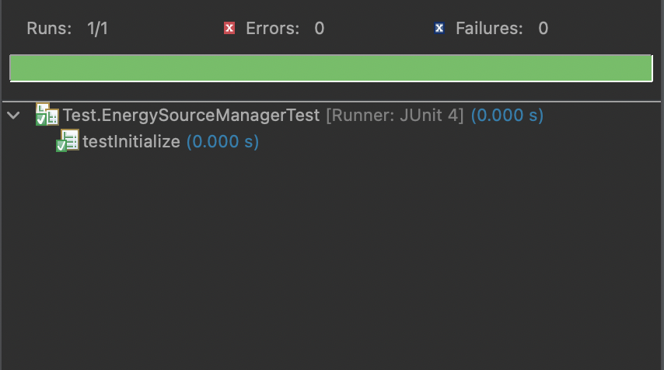
Unit Test

Slide 18
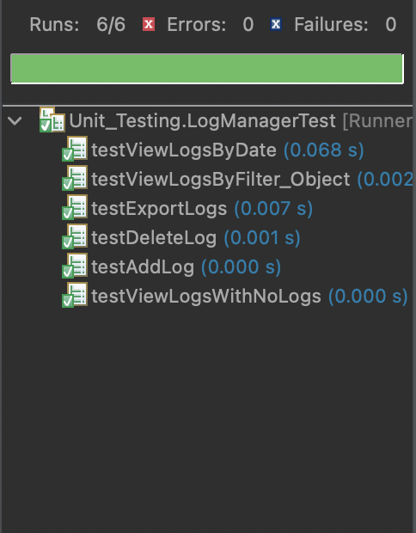
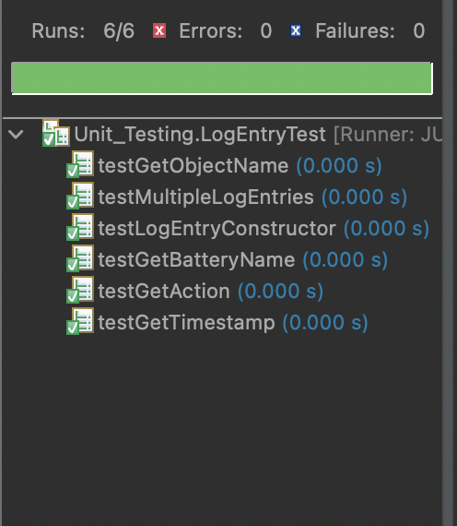
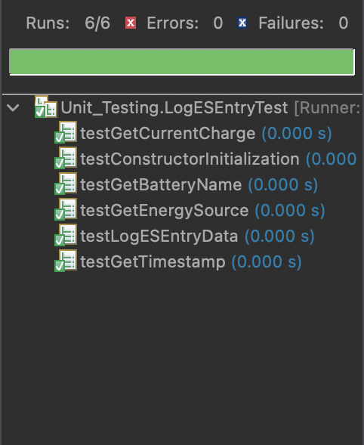
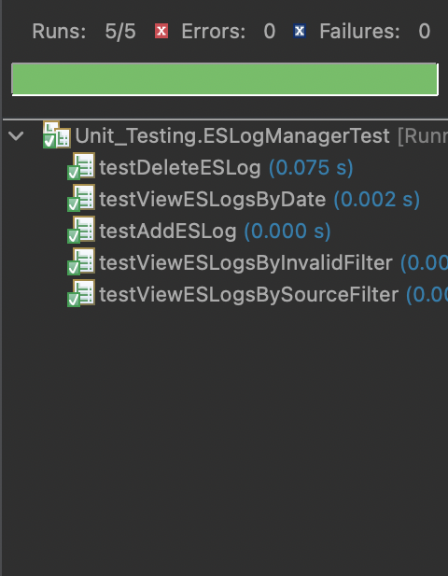
Unit Test

Slide 19
Thank You!

